Slide 1
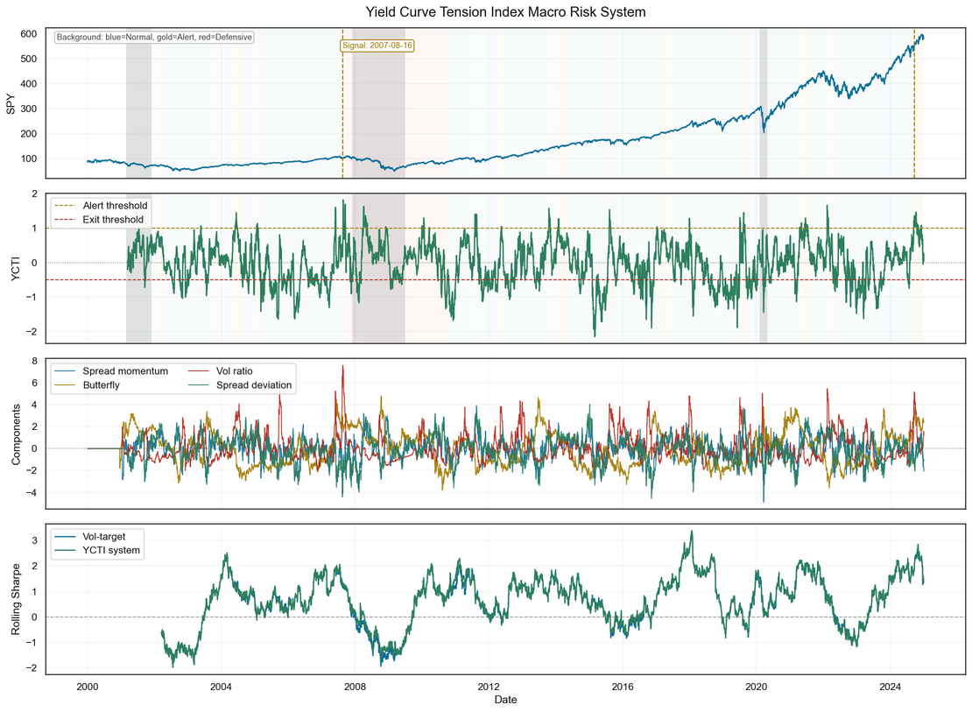
Yield Curve Tension Index: Quantifying Macro Stress for Risk-Aware Equities Trading
Unsupervised HMM captures 94.3% of recession
days from yield curve shape alone — no labels
YCTI predicts forward volatility:
β = 0.0165 | t = 2.14 | p = 0.032
Newey-West corrected | n = 6,268 days
Portfolio Impact:
Strategy Sharpe Max Drawdown
Buy & Hold 0.451 -59.6%
Vol-Targeting 0.596 -27.6%
YCTI Overlay 0.644 -26.3%
Cross Market Recession Capture:
Germany 74% (5 recessions)
UK 82% (4 recessions)
Canada 100% (2 recessions)
15 total recession episodes
YCTI overlay on SPY 2000-2024. Signal fired August 16, 2007 — 347 days before the GFC trough.
Key limitation: 3 U.S. recessions is insufficient for statistical validation of timing claims.
YCTI is a macro risk conditioning tool, not a standalone forecast model.

